Slide 1



ECDH Generation of a mutual key in group of 3 users + texts encryption/decryption with SALSA20 in CFB mode + Rabin signature

Slide 2





Almog Kadosh
Eyal Cohen
Guy Pariente
Almog Elbaz

Slide 3
Introduction
Our project aims to develop a secure messages exchange application using advanced encryption techniques to ensure the confidentiality and integrity of messages exchanged between users. We will implement the SALSA20 algorithm for symmetric encryption in CFB (ciphertext feedback) mode, and the Elliptic Curve Diffie-Hellman method for generating a mutual key in a group of 3 users, along with Rabin signature for secure key delivery and authentication.

Slide 4
Project Workflow
Step 1: Key Generation
Implementing the Elliptic Curve Diffie-Hellman method to generate a shared key among three users, ensuring that all users can encrypt and decrypt messages securely.
Step 2: Encryption/Decryption
Applying the SALSA20 algorithm in CFB (Ciphertext Feedback) mode for message encryption. The encryption details include the key scheduling process, the encryption itself, and the corresponding decryption process.
Step 3: Authentication
Using Rabin digital signature to authenticate and secure the encryption keys, ensuring that the keys have not been tampered with or altered during transmission.
Step 4: Sending and Receiving
Every message sent is encrypted using the SALSA20 key and is verified before opening through Rabin’s digital signature to authenticate the source and integrity of the content.
Notes:
המטרה של הפרויקט היא לפתח אפליקציה להחלפת דואר אלקטרוני בטוחה, שמשתמשת בטכניקות הצפנה מתקדמות על מנת לשמור על חשאיות ושלמות ההודעות שמועברות בין המשתמשים.

Slide 5
Key Components
Rabin Signature: We'll use the Rabin signature method to verify the source of the messages, ensuring that messages are from legitimate sources and haven't been tampered with by malicious entities.
ECDH for Generating a Mutual Key in a Group of 3 Users: Using Elliptic Curve Diffie-Hellman (ECDH) for generating a mutual key in a group of 3 users. This technique allows the creation of a shared key securely among three users without the need to transmit the key itself through the communication channel.
SALSA20 for Symmetric Encryption in CFB Mode: Implementation of the SALSA20 algorithm for secure encryption and decryption of email messages in CFB (ciphertext feedback) mode. This algorithm offers strong cryptographic properties, including high-speed encryption and resistance against various attacks.

Slide 6


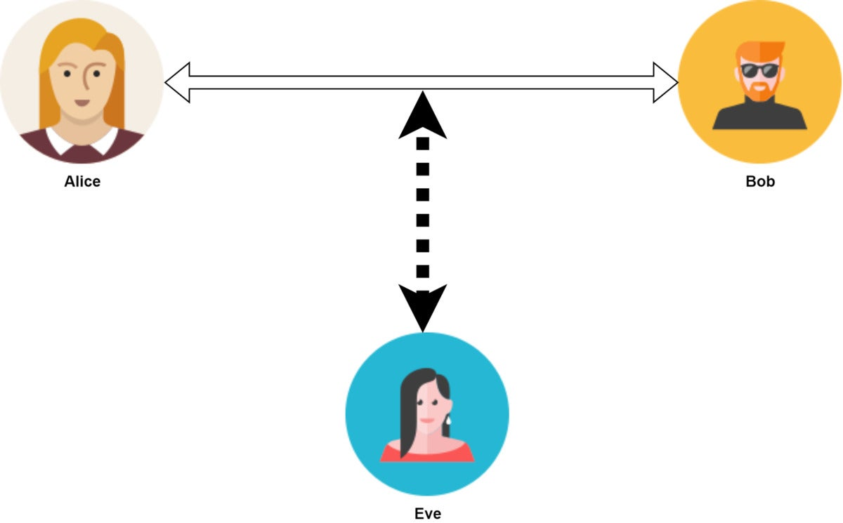

What is Diffie-Hellman
Diffie-Hellman is a key exchange protocol that allows two parties to securely share a secret key over an insecure communication channel. This key can then be used to encrypt subsequent communications using symmetric key cryptography.
Why we need Diffie-Hellman ?
The Diffie-Hellman key exchange is essential because it enables secure sharing of a secret key over an insecure channel requiring minor prior communication, facilitating encrypted communications.
Charlie

Slide 7
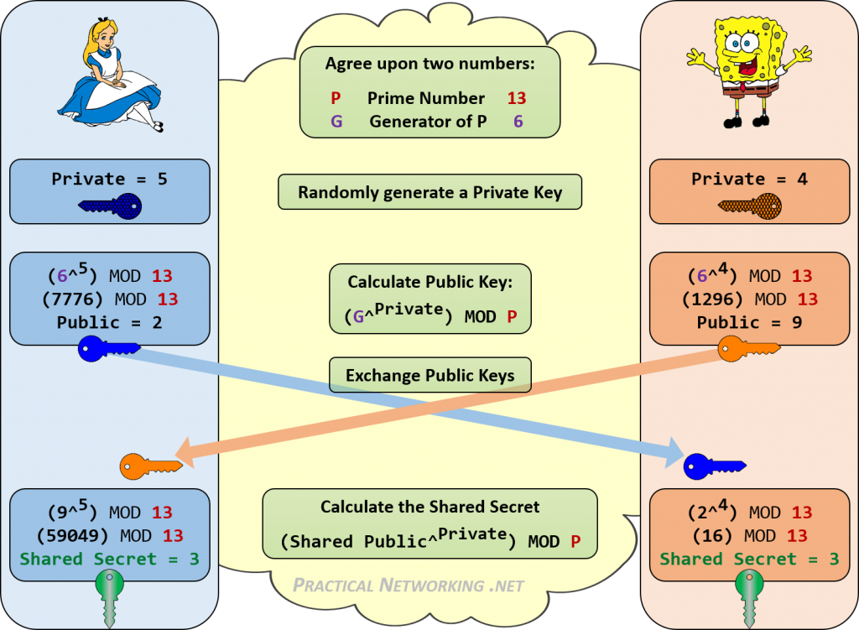
How does Diffie-Hellman work?
Agreement on Common Parameters: Both parties agree on a prime number and a base, which are public and known to everyone.
Private and Public Keys: Each party selects a private key secretly and computes a public key from it. The public keys are then exchanged between them.
Shared Secret Calculation: Each party uses their own private key and the other party’s public key to compute the shared secret. This computation ensures that both parties arrive at the same secret key, despite the insecure channel.
The shared secret key is now used to encrypt and decrypt messages using a symmetric encryption method, ensuring that communication remains confidential and secure.

Slide 8
Advantage’s of Diffie-Hellman
Secure Key Agreement Facilitates the agreement on a shared secret key between all the parties without prior communication or secret exchange.
Robust Security Even if the key exchange is observed, security remains intact with large secret values, enhancing resistance against attacks.
Efficient Implementation The algorithm is efficient and easy to implement, suitable for various cryptographic applications.

Slide 9
Advantage’s of Diffie-Hellman
Vulnerability to Interception Prone to man-in-the-middle attacks if an attacker intercepts and alters the exchanged messages between parties. Computational Intensity Utilizes large prime numbers, potentially leading to computational burden and slower processing in some scenarios. Lack of Authentication It lacks built-in authentication mechanisms, necessitating additional steps for parties to verify each other's identities securely.

Slide 10
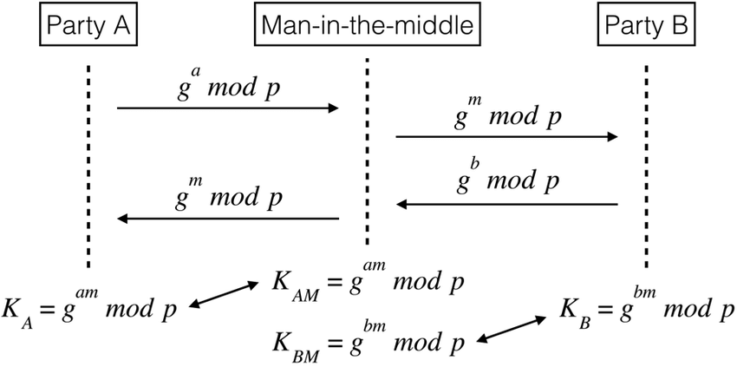
Advantage’s of Diffie-Hellman
A man-in-the-middle (MITM) attack is a cyber attack where an attacker intercepts communication between the parties and disguises themselves as one of the parties. This allows the attacker to gain access to sensitive information without either party realizing that their communication has been compromised.

Slide 11
Third party in Diffie-Hellman
The parties agree on the algorithm parameters p and g.
The parties generate their private keys, named a, b, and c.
Alice computes gª mod p and sends it to Bob.
Bob computes (gª)^{b} mod p = g^{ab} mod p and sends it to Charlie.
Charlie computes (g^{ab})^{c} mod p = g^{abc} mod p and uses it as her secret.
Bob computes g^{b} mod p and sends it to Charlie.
Charlie computes (g^{b})^{c} mod p = g^{bc} mod p and sends it to Alice.
Alice computes (g^{bc})ª mod p = g^{bca} mod p = g^{abc} mod p and uses it as her secret.
Charlie computes g^{c} mod p and sends it to Alice.
Alice computes (g^{c})ª mod p = g^{ca} mod p and sends it to Bob.
Bob computes (g^{ca})^{b} mod p = g^{cab} mod p = g^{abc} mod p and uses it as his secret.
An eavesdropper has been able to see gª mod p, g^{b} mod p, g^{c} mod p,
g^{ab} mod p, g^{ac} mod p, and g^{bc} mod p, but cannot use any combination
of these to efficiently reproduce g^{abc} mod p.

Slide 12



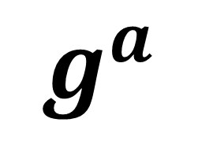
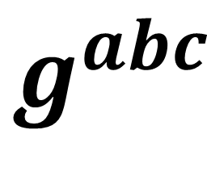
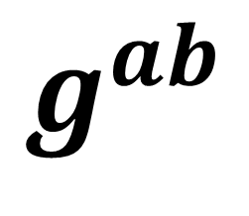
$$g^{a}$$
$$g^{ab}$$
$$g^{abc}$$
Alice Private key: a Public key: g^a
Bob Private key: b Public key: g^ab
Charlie Private key: c Public key: g^abc

Slide 13
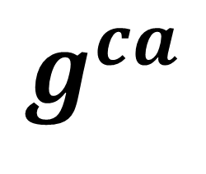
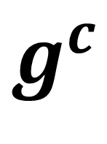
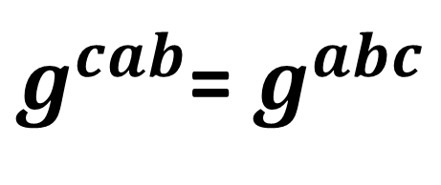
$$g^{ca}$$
$g^{cab}$= $g^{abc}$
Alice Private key: a Public key: g^ca
Bob Private key: b Public key: g^cab
$$g^{c}$$
Charlie Private key: c Public key: g^c

Slide 14
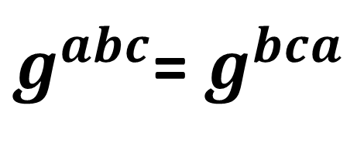
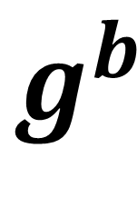
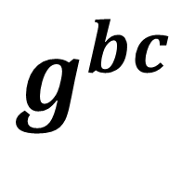
$g^{abc}$= $g^{bca}$
Alice Private key: a Public key: g^bca
Bob Private key: b Public key: g^b
$$g^{b}$$
$$g^{bc}$$
Charlie Private key: c Public key: g^bc

Slide 15
Elliptic Curve Diffie-Hellman (ECDH)
Elliptic Curve Diffie-Hellman (ECDH) is a key exchange protocol that enhances the classical Diffie-Hellman approach by utilizing elliptic curves. It enables two parties to securely generate a shared secret over an insecure channel. An elliptic curve is represented by the equation $y^{2}=x^{3}+ax+b$over a finite field $ℤ_{p}$ .
$a,b$are randomly generated every run according to the required conditions.
$a,b∈ℤ_{p} s.t 4a^{3}+27b^{2}≠0$, $p>3 prime and a,b<p.$

Slide 16
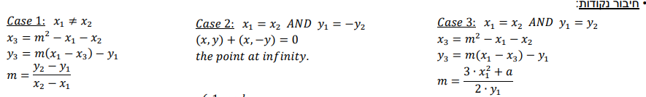
Elliptic Curve Diffie-Hellman (ECDH)
When you connect two points on an elliptic curve, you get another point on the curve.

Slide 17
Key Exchange:
Step 1: Alice and Bob chooses their private key $a_{1}, b_{1}$
Step 2: there is a Base point called B on the Elliptic Curve. Now, Alice and Bob generate their public key $a_{2}=B⋅a_{1}$ , $b_{2}=B⋅b_{1}$
Step 3: Alice send $a_{2}$ to Bob and Bob sends $b_{2}$ to Alice.
.
Step 4: Alice generates $K_{ab}=a_{1}⋅b_{2} mod p$ and Bob generates $K_{ba}=b_{1}⋅a_{2} mod p$.
$$K_{ab}=K_{ba} because$$
${ a}_{1}⋅b_{2}$ mod p = $a_{1}⋅B⋅b_{1}$ $mod(p)$ = $a_{2}⋅b_{1}mod (p)$

Slide 18
How ECDH Works
Private and Public Keys: Participants choose a private key randomly and generate a public key via scalar multiplication of the base point on the elliptic curve.
Key Exchange: Public keys are exchanged without compromising security.
Shared Secret Calculation: The shared secret is computed using the received public key and one's own private key, resulting in a point on the elliptic curve used as the shared secret.

Slide 19

$$DH: X=g^{x} mod\left(p\right)$$
$$↓$$
$$ECDH: A=a⋅B mod\left(p\right)$$
Where A is (x,y) public key, a is Alice’s private key and B is the base point.
If we compare them side by side, we can say that:
$X≡A, g≡B, x≡a$
* This is an example of Bob sends to Alice his public key B and Alice generates with her private key a the common key.

Slide 20
DH vs. ECDH
Security: ECDH provides similar levels of security as DH but with significantly shorter keys. ECDH offers equivalent or better security with smaller keys. The use of elliptic curves introduces additional security benefits, such as resistance to certain types of attacks.
Efficiency: Smaller key sizes in ECDH lead to faster computations and less bandwidth usage, making it more efficient than traditional DH. This is due to the fact that DH involves modular exponentiation, which is computationally intensive and slower compared to the operations used in ECDH .
Flexibility: ECDH supports various elliptic curves, allowing security and performance tuning according to specific needs.

Slide 21
What is Salsa20 ?
Salsa20 is a symmetric key stream cipher. It uses a 256-bit key and a 64-bit nonce, along with a 64-bit stream position, to create a keystream of any length. This keystream is XORed with the plaintext to produce ciphertext.
What is keystream?
A keystream is a sequence of random or pseudorandom bits used for encryption. When combined with plaintext, it creates ciphertext that can be securely sent over an insecure channel.

Slide 22
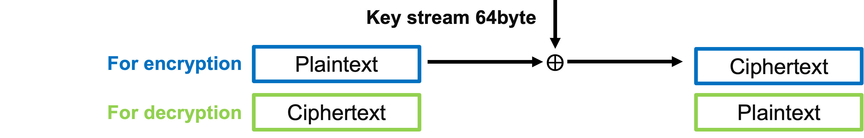
Salsa20 Algorithm
The initial
state matrix includes:
Salsa key K 256 bit
Salsa20 Expansion function
The Salsa20 hash function
Nonce n
64 bit
10 Rounds of doubleround function
Stream position
(block index)
64 bit

Slide 23
Key Features of Salsa20
High Speed: Capable of encrypting data quickly, making it suitable for high-performance applications.
Efficiency: Uses simple arithmetic operations that are computationally inexpensive.
Security: Proven to be resistant to various cryptanalytic attacks.

Slide 24
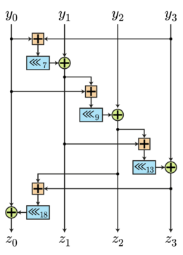
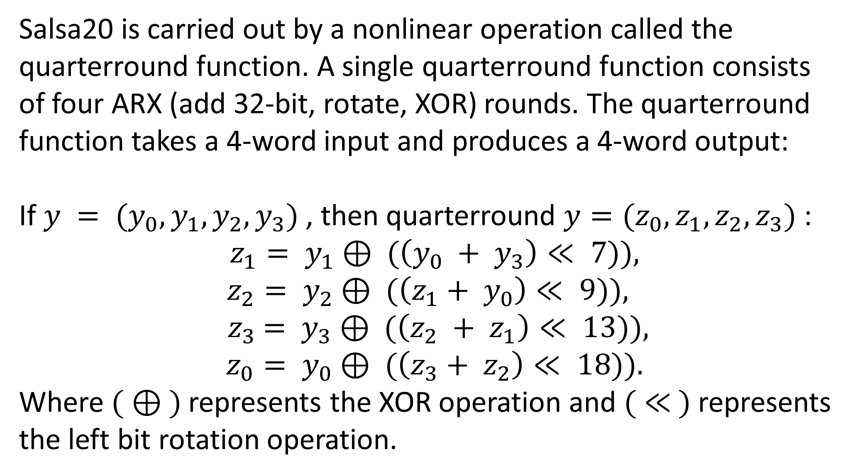
The quarterround function
Salsa20 is carried out by a nonlinear operation called the quarterround function. A single quarterround function consists of four ARX (add 32-bit, rotate, XOR) rounds. The quarterround function takes a 4-word input and produces a 4-word output:
If$y = (y_{0}, y_{1}, y_{2}, y_{3})$, then quarterround $y=(z_{0}, z_{1}, z_{2}, z_{3})$ :
$$z_{1}= y_{1}⊕ (\left(y_{0} + y_{3}\right)≪ 7)),$$
$$z_{2}= y_{2}⊕ (\left(z_{1}+ y_{0}\right)≪ 9)),$$
$${ z}_{3} = y_{3}⊕ (\left(z_{2} + z_{1}\right)≪ 13)),$$
$$z_{0}= y_{0}⊕ (\left(z_{3}+ z_{2}\right)≪ 18)).$$
Where $( ⊕ )$represents the XOR operation and $( ≪ )$represents the left bit rotation operation.

Slide 25
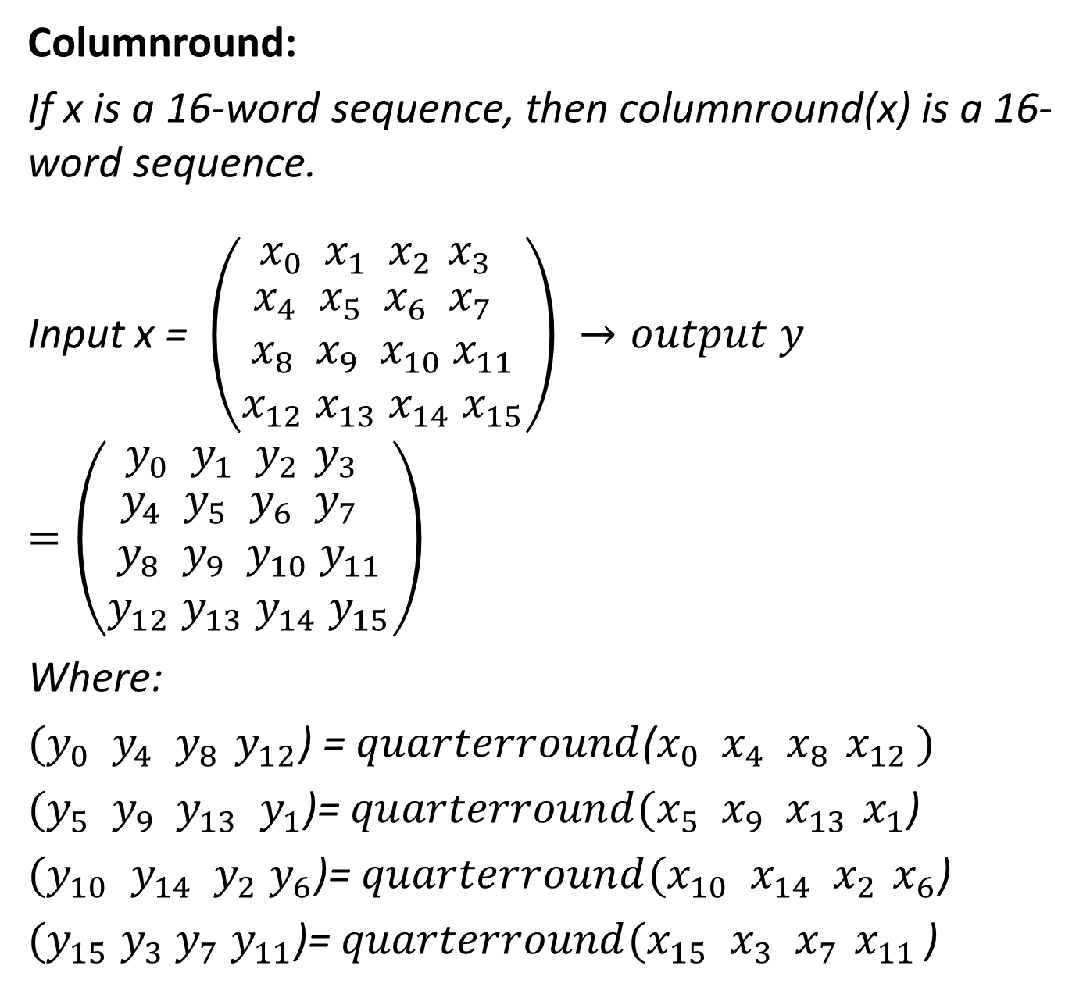
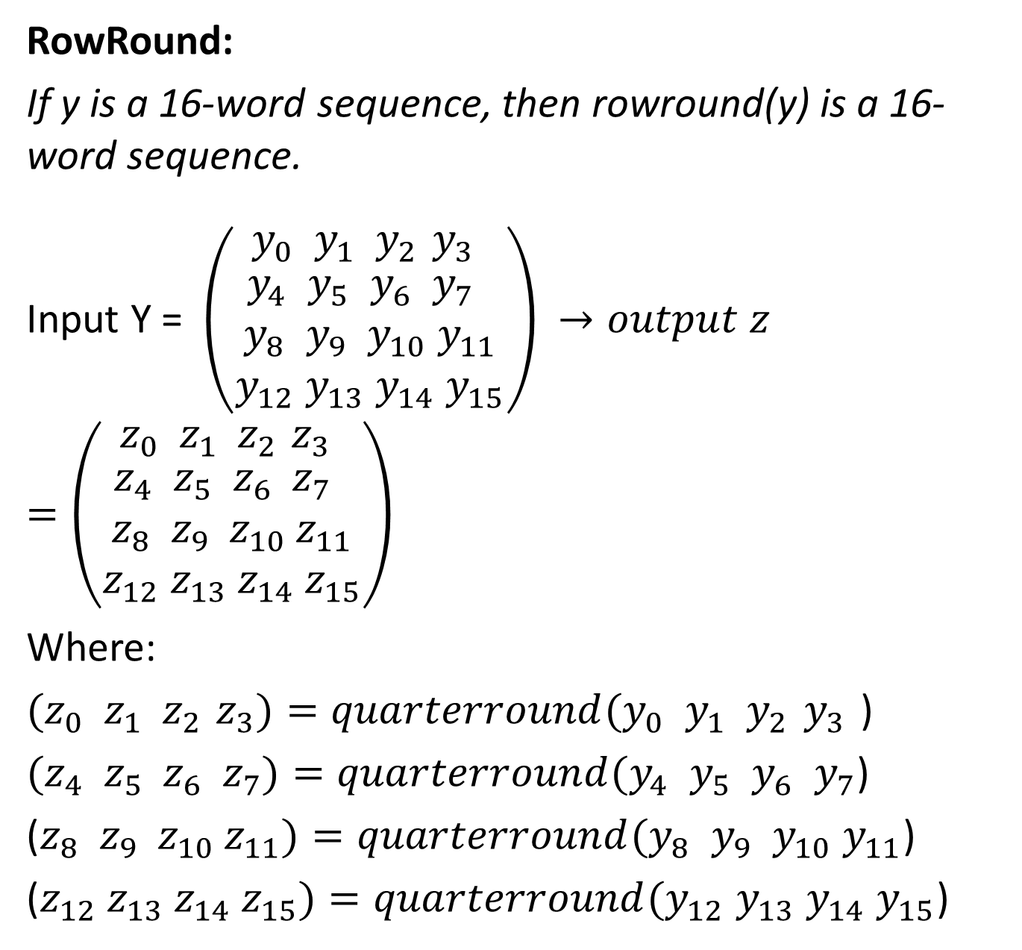
More Functions
RowRound:
If y is a 16-word sequence, then rowround(y) is a 16-word sequence.
Input Y = $\left(\begin{matrix}{y_{0} y}_{1}{ y}_{2 }y_{3 } \\ \begin{aligned}{y_{4} y}_{5} y_{6} y_{7} \\ {y_{8} y}_{9} { y}_{10} y_{11} \\ y_{12} y_{13} y_{14} y_{15}\end{aligned}\end{matrix}\right)$ $→output z=\left(\begin{matrix}{z_{0} z}_{1}{ z}_{2 }z_{3 } \\ \begin{aligned}{z_{4} z}_{5} z_{6} z_{7} \\ {z_{8} z}_{9} { z}_{10} z_{11} \\ z_{12} z_{13} z_{14} z_{15}\end{aligned}\end{matrix}\right)$
Where:
${{(z}_{0} z}_{1}{ z}_{2 }z_{3})=quarterround({y_{0} y}_{1}{ y}_{2 }y_{3 }$)
$({z_{4} z}_{5} z_{6} z_{7})=quarterround({y_{4} y}_{5} y_{6} y_{7}$)
(${z_{8} z}_{9} { z}_{10} z_{11})=quarterround({y_{8} y}_{9} { y}_{10} y_{11}$)
($z_{12} z_{13} z_{14} z_{15})=quarterround(y_{12} y_{13} y_{14} y_{15}$)
Columnround:
If x is a 16-word sequence, then columnround(x) is a 16-word sequence.
Input x = $\left(\begin{matrix}{x_{0} x}_{1}{ x}_{2 }x_{3 } \\ \begin{aligned}{x_{4} x}_{5} x_{6} x_{7} \\ {x_{8} x}_{9} { x}_{10} x_{11} \\ x_{12} x_{13} x_{14} x_{15}\end{aligned}\end{matrix}\right)$ $→output y=\left(\begin{matrix}{y_{0} y}_{1}{ y}_{2 }y_{3 } \\ \begin{aligned}{y_{4} y}_{5} y_{6} y_{7} \\ {y_{8} y}_{9} { y}_{10} y_{11} \\ y_{12} y_{13} y_{14} y_{15}\end{aligned}\end{matrix}\right)$
Where:
$({y_{0} y}_{4}{ y}_{8 }y_{12}$) = $quarterround$(${x_{0} x}_{4}{ x}_{8 }x_{12 })$
$({y_{5} y}_{9} y_{13} y_{1}$)= $quarterround({x_{5} x}_{9}{ x}_{13 }x_{1}$)
$({y_{10} y}_{14} { y}_{2} y_{6}$)= $quarterround({x_{10} x}_{14}{ x}_{2 }x_{6}$)
$(y_{15} y_{3} y_{7} y_{11}$)= $quarterround({x_{15} x}_{3}{ x}_{7 }x_{11 }$)

Slide 26
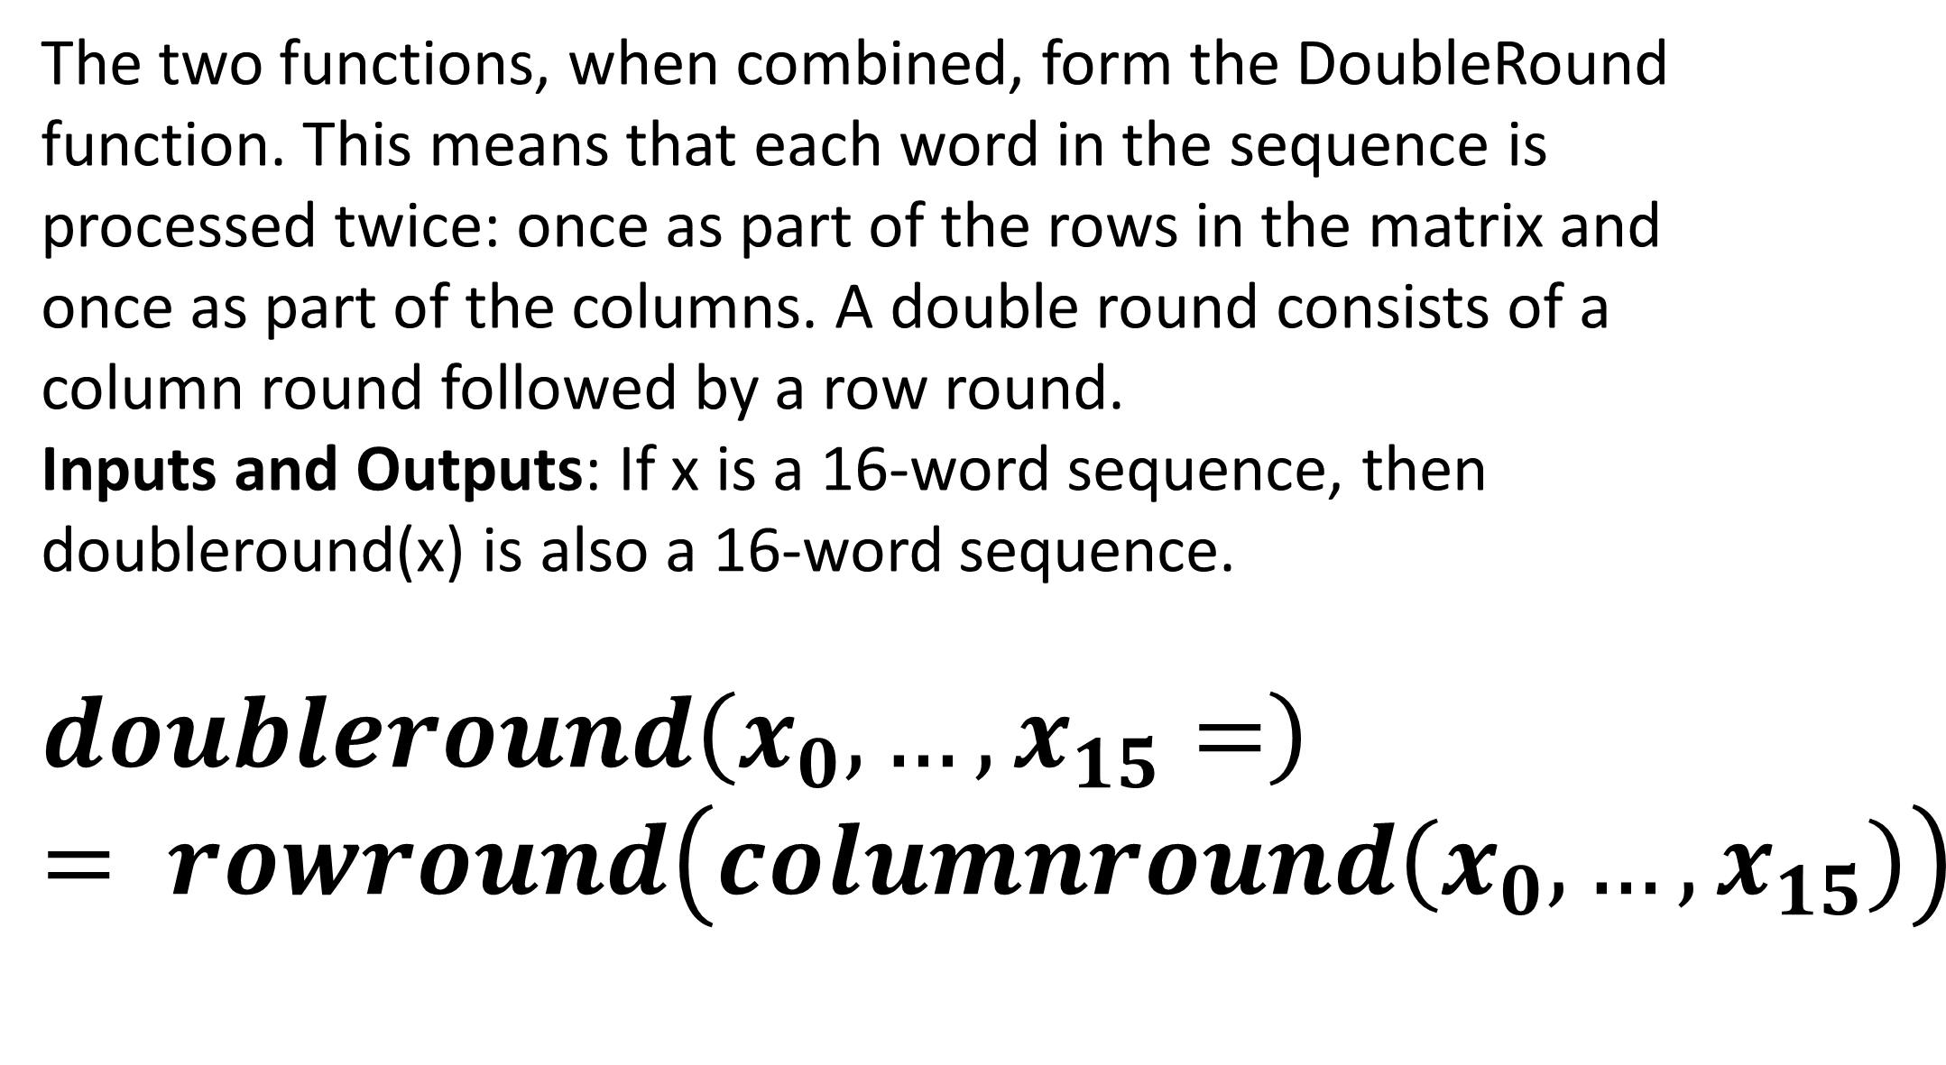
Doubleround Function
The two functions, when combined, form the DoubleRound function. This means that each word in the sequence is processed twice: once as part of the rows in the matrix and once as part of the columns. A double round consists of a column round followed by a row round.
Inputs and Outputs: If x is a 16-word sequence, then doubleround(x) is also a 16-word sequence.
$$doubleround\left(x_{0},…,x_{15}=\right)= rowround\left(columnround\left(x_{0},…,x_{15}\right)\right)$$

Slide 27
In Salsa20
In the Salsa20 algorithm, the DoubleRound function is performed 10 times.
Each DoubleRound consists of a column round followed by a row round. This means that in total, the input is processed through 20 rounds of transformation, enhancing the security of the encryption by thoroughly mixing the input data.

Slide 28
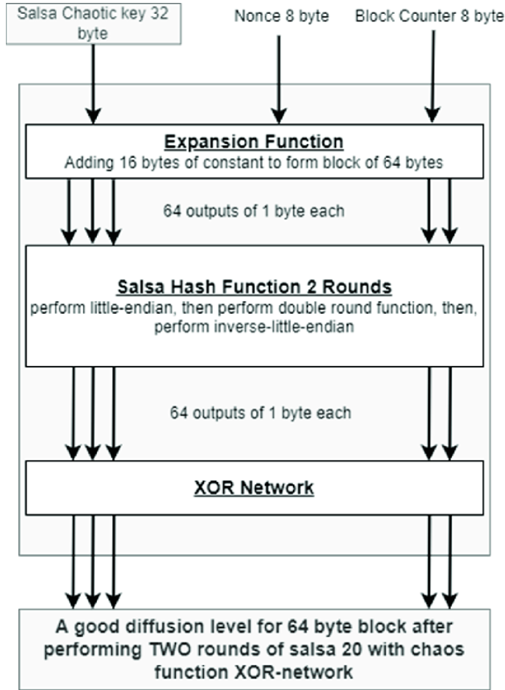
The Expansion function
Inputs and outputs:
If k is a 32-byte sequence and n is a 16-byte sequence, then Salsa20k(n) is a 64-byte sequence.
Notes:
The expansion phase prepares the initial state matrix using the key, nonce, and stream position. This matrix will then be processed by the hash function.
This matrix is expanded from 48 bytes (the combined length of the key, nonce, and stream position) to 64 bytes by adding fixed constants.
We do the expansion by adding 4 fixed 4 bytes constants

Slide 29
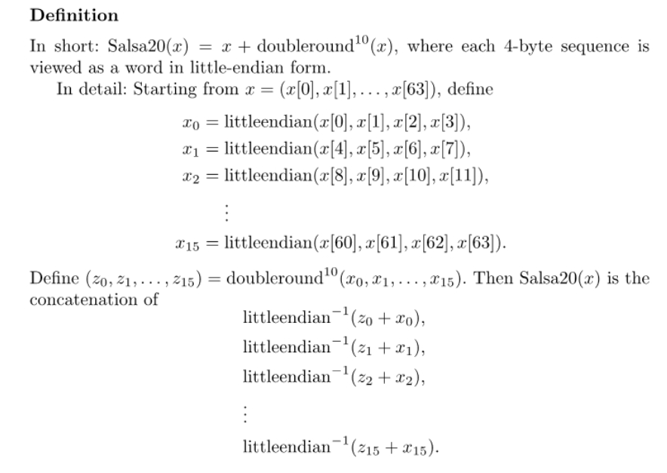
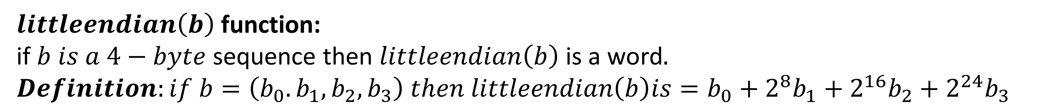
Salsa20’s Hash function
$littleendian\left(b\right)$ function: if $b is a 4−byte$ sequence then $littleendian\left(b\right)$is a word$.$ $Definition:if b=\left(b_{0}.b_{1},b_{2},b_{3}\right) then littleendian\left(b\right)is=b_{0}+2^{8}b_{1}+2^{16}b_{2}+2^{24}b_{3}$
Notes:
After the expansion phase, we have a 65 byte long sequence. The output of the hash function will be transformed version of the input sequence.
The input is divided to 16 words, each 4 bytes long in Little-endian form (LSB is stored first – 0x78, 0x56, 0x34, 0x12 example).
The doubleround function is applied 10 times in sequence, doubleround includes xor and left rotation by number of bits, example:
For input Four 32-bit words: y0, y1, y2, y3
Doubleround Will get - z1 = y1 ^ ((y0 + y3) <<< 7)

Slide 30
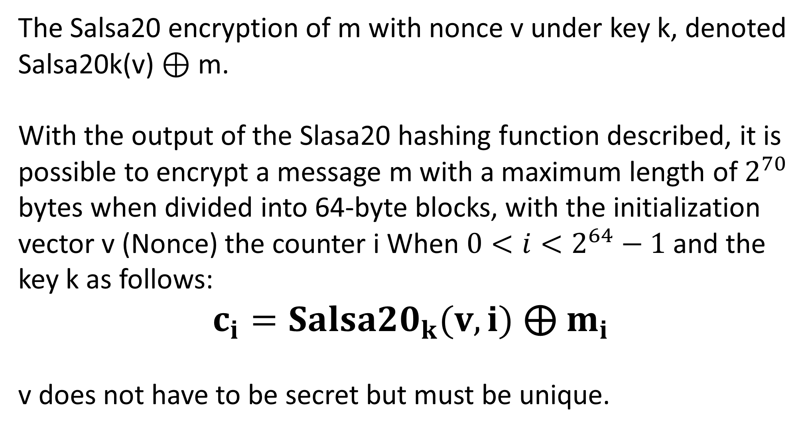
Salsa20 Encryption
The Salsa20 encryption of m with nonce v under key k, denoted Salsa20k(v) ⊕ m.
With the output of the Slasa20 hashing function described, it is possible to encrypt a message m with a maximum length of $2^{70}$ bytes when divided into 64-byte blocks, with the initialization vector v (Nonce) the counter i When $0<i<2^{64}−1$ and the key k as follows:
$c_{i}={Salsa20}_{k}(v,i)$ ⊕ $m_{i}$
v does not have to be secret but must be unique.

Slide 31
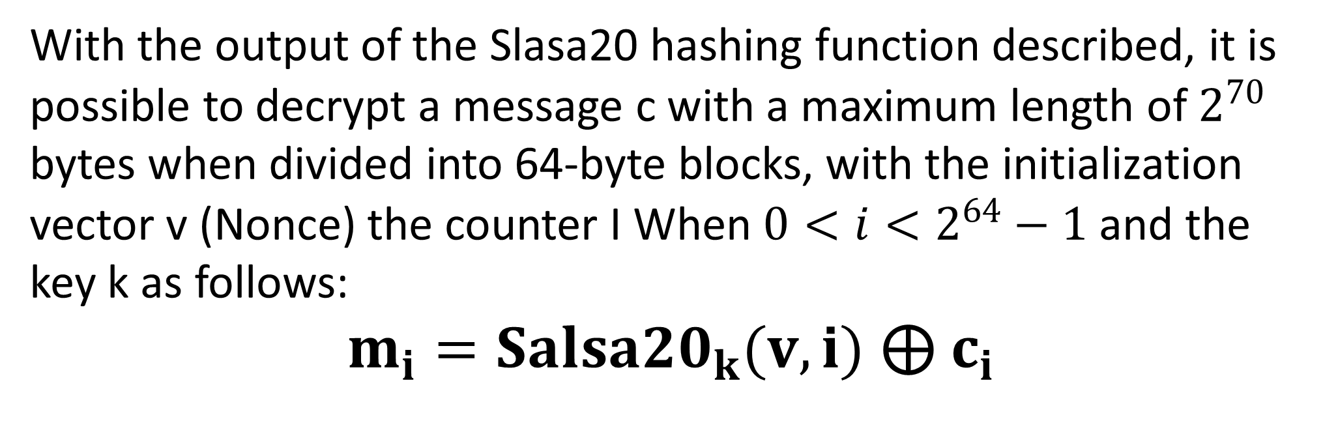
Salsa20 Decryption
With the output of the Slasa20 hashing function described, it is possible to decrypt a message c with a maximum length of $2^{70}$ bytes when divided into 64-byte blocks, with the initialization vector v (Nonce) the counter I When $0<i<2^{64}−1$ and the key k as follows:
$m_{i}={Salsa20}_{k}(v,i)$ ⊕ $c_{i}$

Slide 32
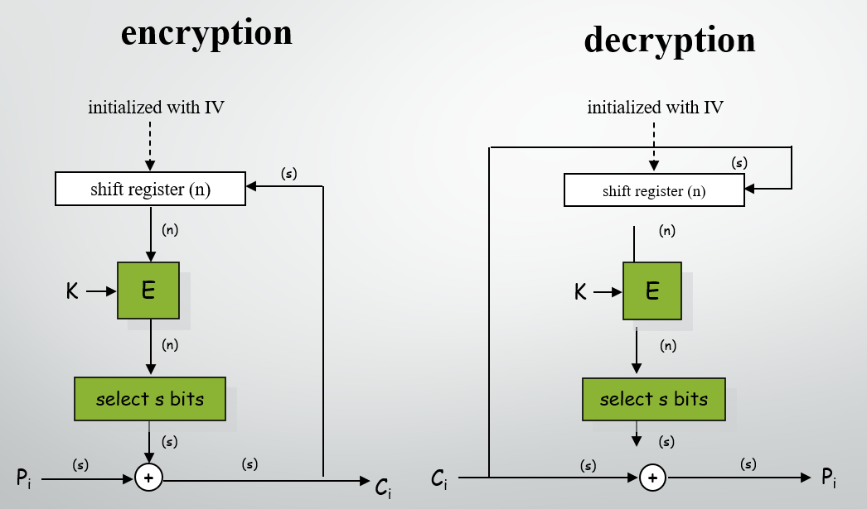
Cipher Feedback (CFB) Mode
Overview:
Cipher Feedback (CFB) mode is a block cipher mode of operation that converts a block cipher into a self-synchronizing stream cipher, allowing for secure encryption of data streams of arbitrary length.
Advantages:
Feedback Mechanism: In CFB mode, part of the previous ciphertext is used as input to the encryption function for the next block, creating a feedback loop.
Self-Synchronizing: CFB mode is self-synchronizing, meaning if some bits are lost or altered, it will automatically resynchronize after a few blocks.

Slide 33
Salsa20 in CFB Mode:
Combination:
Using Salsa20 with Cipher Feedback (CFB) mode combines the speed of the Salsa20 stream cipher with CFB's feedback mechanism. This setup adapts the encryption of each block based on previous ciphertext, ensuring secure and efficient encryption of data streams.

Slide 34
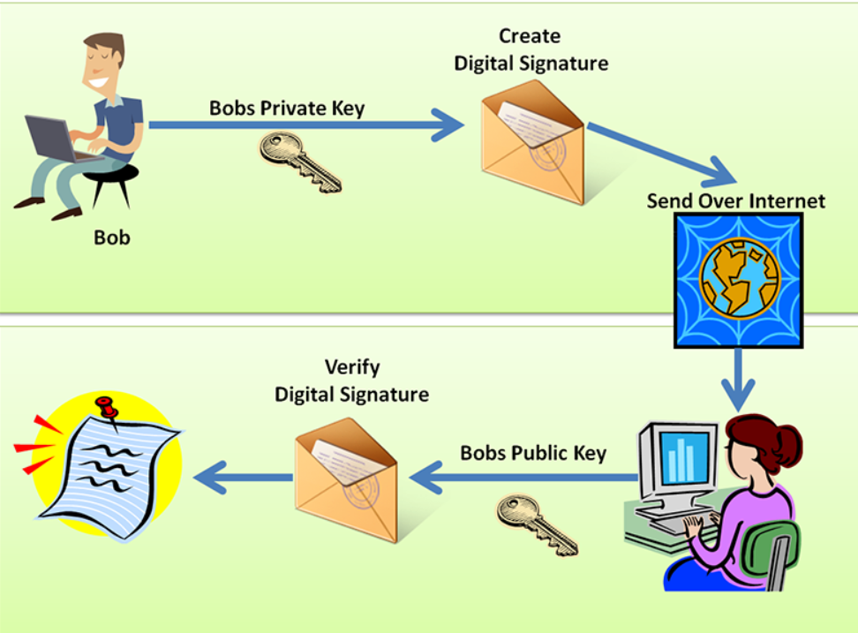
Digital signature:
A digital signature is a mathematical technique used to verify the authenticity of digital messages or documents. When a message bears a valid digital signature, it assures the recipient that the message originated from a sender who is recognized and trusted. Benefits of Digital Signatures: Authenticity: Ensures that the document originated from the identified signer. Integrity: Any modification to the document after signing will invalidate the signature. Non-repudiation: The signer cannot deny having signed the document

Slide 35
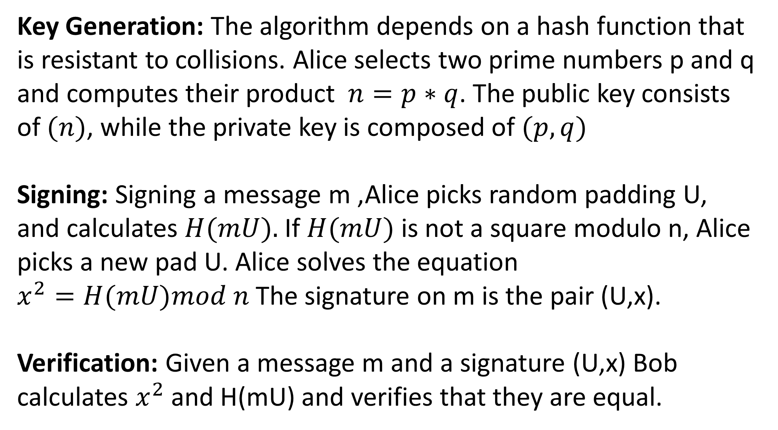
Rabin Signature Algorithm:
Key Generation: The algorithm depends on a hash function that is resistant to collisions. Alice selects two prime numbers p and q and computes their product $n=p∗q$. The public key consists of $(n)$, while the private key is composed of $(p,q)$ Signing: Signing a message m ,Alice picks random padding U, and calculates $H(mU).$If $H(mU)$is not a square modulo n, Alice picks a new pad U. Alice solves the equation
$x^{2}=H(mU)mod n$The signature on m is the pair (U,x). Verification: Given a message m and a signature (U,x) Bob calculates $x^{2}$and H(mU) and verifies that they are equal.

Slide 36
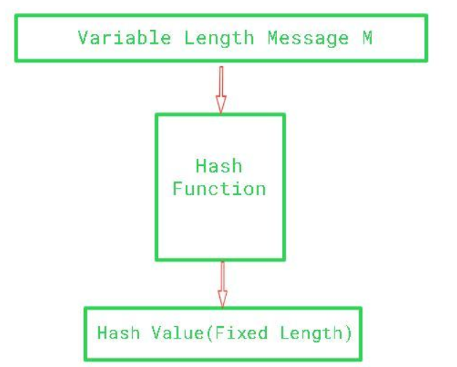
Rabin’s Hash Functions:
Hash functions are functions that given an input of any kind will map that input to a curtain value. For Rabin signature where the hash functions gets a string, it is also mandatory to return a fixed length mapped value. Usually means adding 0bits. Hash functions are required to have collision resistance. Collision is where two different x,y yields same hashed value h(x)=h(y) this can damage the reliability of Rabin signature and therefore the hash function is required to have extremely low probability for such case to happen.

Slide 37
Rabin signature in our code:
sign = Rabin.sign_rabin(sender.p, sender.q, binascii.hexlify(sender.plainText)) In this line we can see how signing a curtain message is unique both to the sender and to the message itself, resulting in all the benefits of Rabin signature. After that the message is verified in the code via: verification = Rabin.verify(sender.rabin_public, hexmessage, sign[0], sign[1]) we can see how we rely on the public key which is computed on p*q private keys, as well as the message itself along with the given padding and signature. This verification results on the confidence of knowing who the sender is, if the message was reshaped in anyway on the transport and it cannot be denied by the sender.

Slide 38
Algorithms Integration
ECDH Each user gets a prime number. We generate a base point which is the same for all the users and we calculate the shared point with the help of the generated point, a random prime number and each of the users prime of key.
Each user read the shared point of each other and if it is matches, we can assume ECDH has been properly implemented
.
SALSA20 - We then derive 64-byte salsa key from the ECDH shared point. and each user receives this shared key. The users also share a vector nonce of 64 bytes which they use together with the shared salsa key to encrypt a decrypt plain and cipher text.
*note that if ECDH failed the program will not be able to salsa encrypt and decrypt using the right key.

Slide 39
Algorithms Integration
Rabin Signature-Right before we encrypt our text using the salsa keys we generated and derived. We sign the message using Rabin signature method which relies on each user’s p, q random primes as well as the product of n = p*q where n is the Rabin public key of the user specifically.
After a user sends the encrypted message to another user, we first decrypt the message using salsa20 CFB which is symmetric, so it means we basically just send the cipher text to the same salsa20 encryption function.
.
After the text is plain, we check the Rabin signature using the plain text and the users public Rabin key, as well as the padding of the given signature to ease up the process of authenticating the signature. If the signature is verified, we display the message, otherwise we mention the verification of signature failed and we cannot trust the plain text to be reliant.

Slide 40
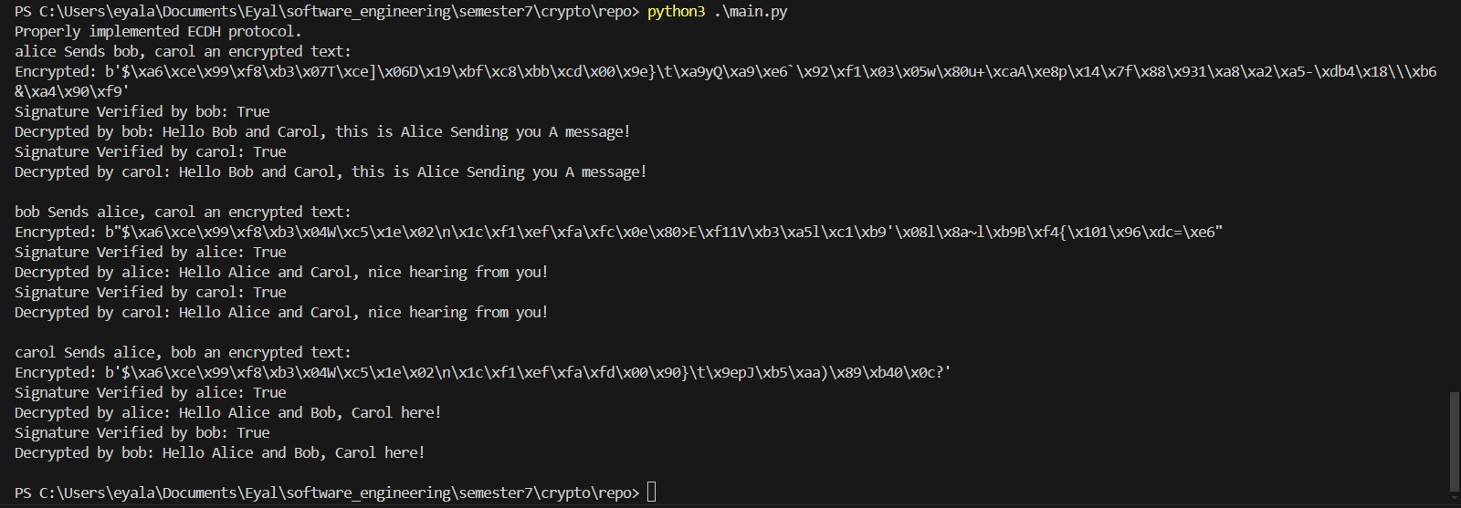
Example run

Slide 41
References:
https://docslib.org/doc/5245573/salsa20-specification
https://en.wikipedia.org/wiki/Salsa20
https://www.geeksforgeeks.org/cryptographic-hash-function-in-java/
https://signx.wondershare.com/knowledge/digital-signature-example.html
https://www.researchgate.net/figure/Salsa20-Block-Diagram-Adapted-with-permission-from-Ref-27_fig3_364449229

Slide 42
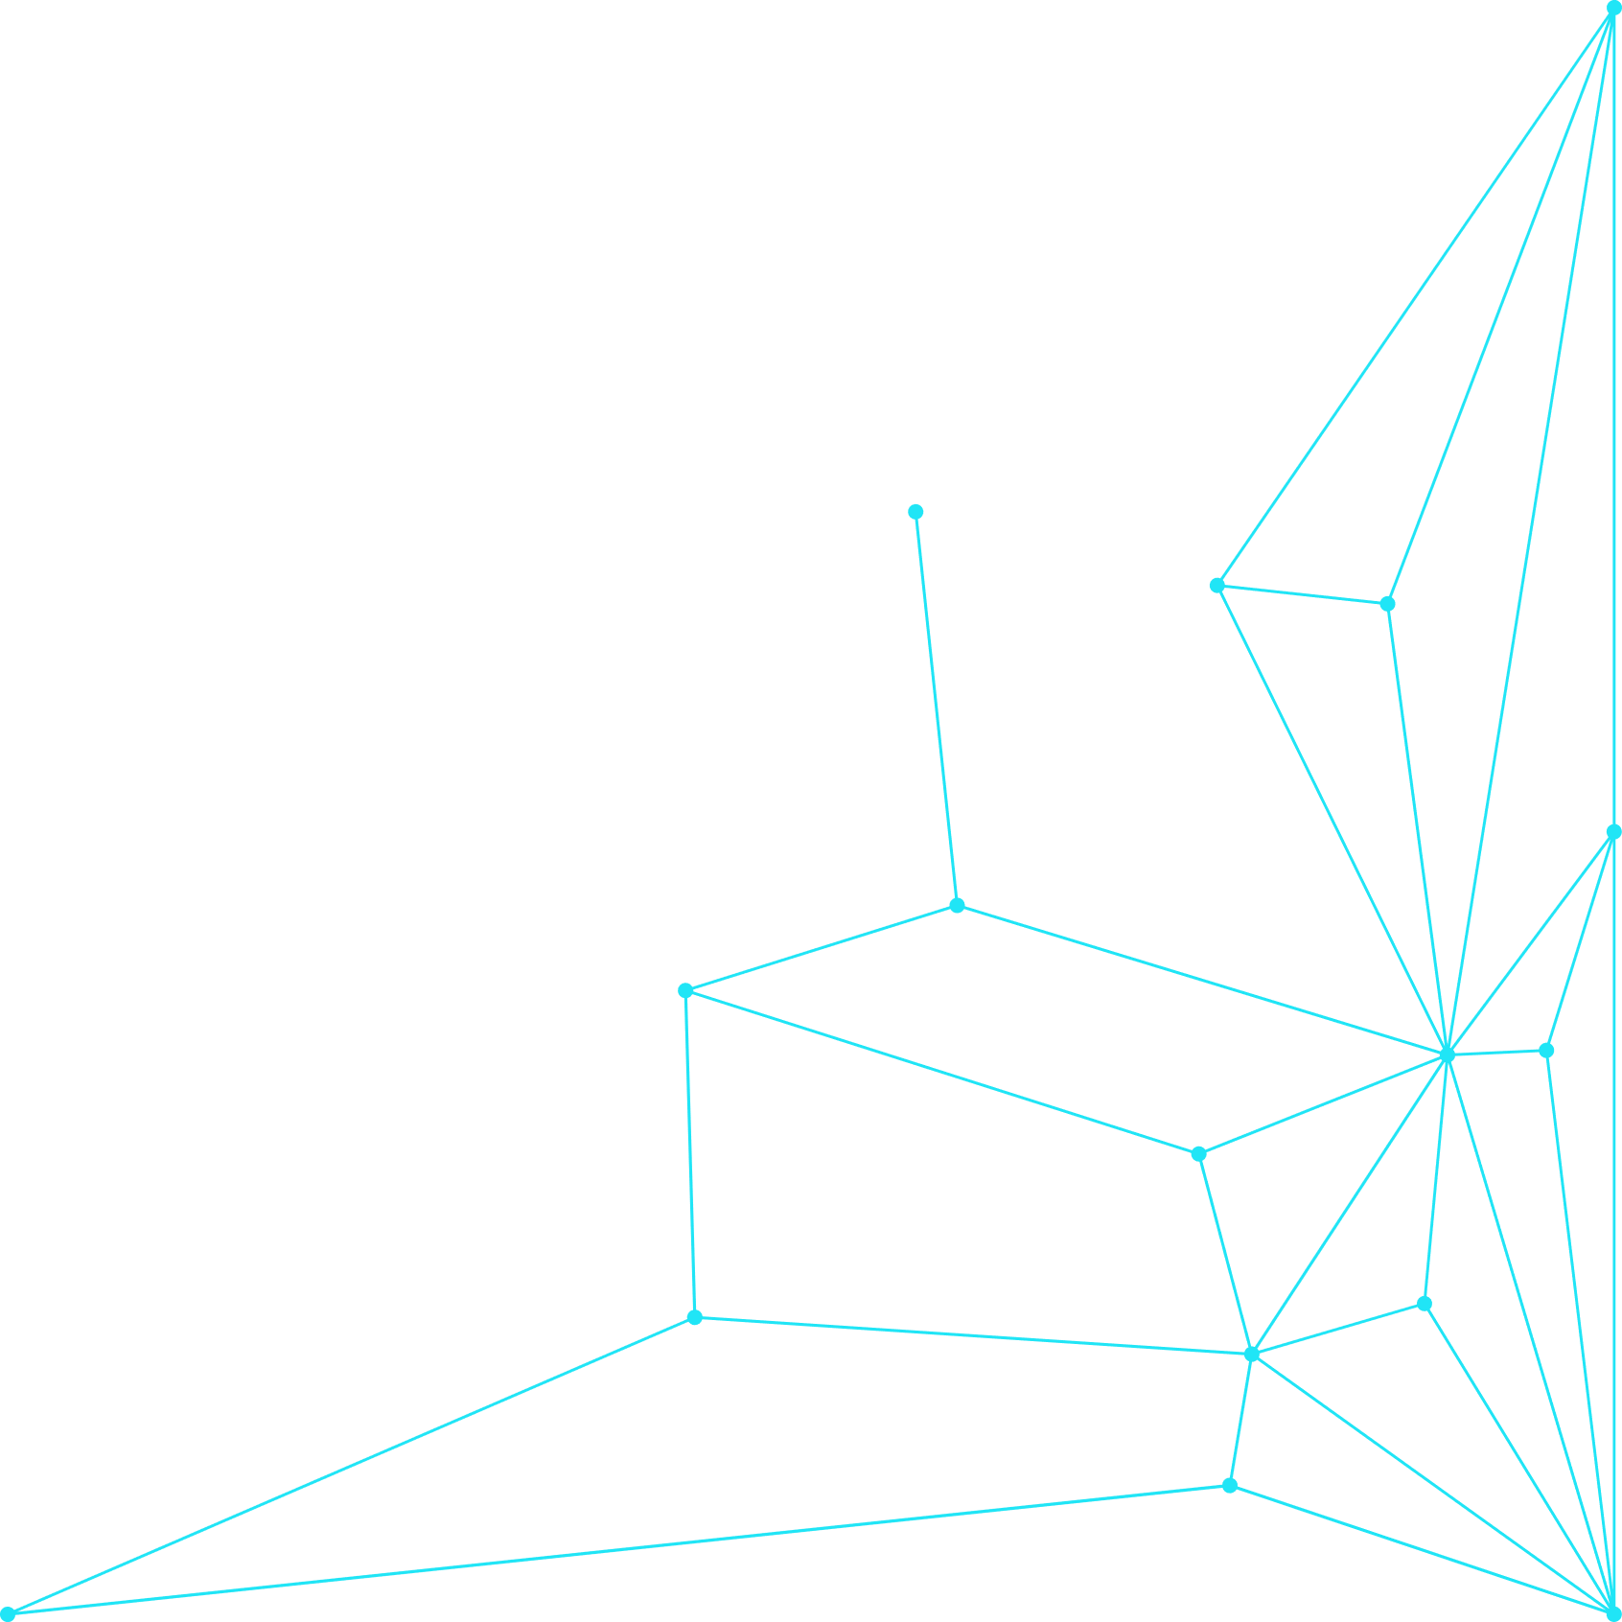

Thank You!

